Slide 1
Cooperative Extension Service: Your Source of Information
Daniel G. Wilson
Ag/NR, ECD, CED
Purdue Extension - Decatur County

Slide 2
History of the Cooperative Extension Service
Purdue University
Cooperative Extension Service
West Lafayette, IN

Slide 3
What Is the Cooperative Extension Service?
Part of a national educational effort
Administered by the Land-Grant University system
Uniquely funded from federal,
state, and local governments

Slide 4
Why Did We Need an Extension Service?
Early universities in the U. S. taught classics / professionals
Harvard, Yale, William and Mary
In the mid-1800s science was gaining importance
Efforts to provide a liberal, practical education to all citizens

Slide 5
The Land Grant University System Is Created
On July 2, 1862 the Morrill Act was signed into law by President Lincoln
Known as the Land-Grant Act
Each state was given public land to be sold
Proceeds used to maintain a college

Slide 6
The Land-Grant Mission
Original mission was to teach:
agriculture
military tactics
mechanical arts
To promote the liberal and practical education of the industrial classes

Slide 7
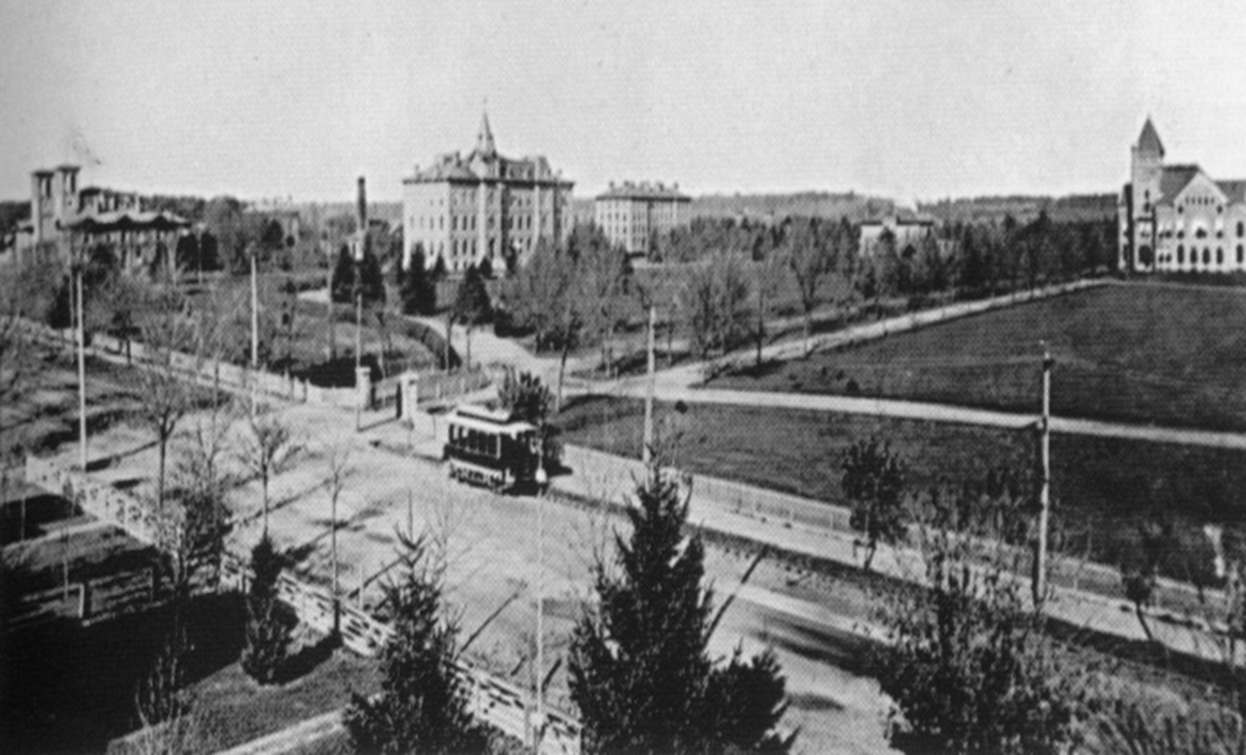
Purdue University Is Created

Slide 8
Research Linked to Land Grant
Experimental farms focused science on the problems of agriculture
Hatch Act passed in 1887
Resulted in growth of experiment
stations and related research to
agriculture

Slide 9
Extending the University to the People
A way was needed to spread new ideas and practices
Early efforts included Farmers’ Institutes and Movable Schools
In 1898, USDA hired Seaman Knapp to “demonstrate” research results to local
farmers in Louisiana

Slide 10
An Early History
Boys’ corn clubs formed at the turn of the century
Started payment of premium money as prizes
First county agents appointed 1906
First home demonstration agents appointed in 1910

Slide 11
The Official Beginning
May 8, 1914 President Woodrow Wilson signed the Smith-Lever Act
Extension Service became the educational arm of the U.S. Department of Agriculture
Established activities within a unique nationwide system
Funded and guided by a national, state, and local government partnership

Slide 12
Extension Through the Years
During WW I, Extension spearheaded the nation's food production effort
During the depression of the 20’s, the emphasis changed from production to economic concerns
Helped to organize farm cooperatives

Slide 13
Extension During the Depression
USDA used Extension to acquaint farmers and rural people to new agencies
Helped people understand emergency government action programs
Home demonstration agents taught home / money management
Indiana Rural Youth - 1934

Slide 14
Extension During the War Years
1941 - Extension took on national defense role
“Food and Feed for Family Living”
“Victory gardens” grown on farms and
backyards
4-H’ers conducted scrap metal drives
Home demonstration agents stressed
food conservation

Slide 15
Extension After the War
Program planning was re-emphasized
More involvement with local people and local situations
New areas of outreach
Community and rural development
Family living

Slide 16
Extension in the 60s and 70’s
Initiated (EFNEP) Expanded Food and Nutrition Education Program
Continued expansion of Community Development
Name changed from Agricultural Extension Service to Cooperative Extension Service
Changed agent titles to County Extension Agent
Purdue system moved to an area approach in 1966

Slide 17
Extension in the 80s and 90s
“Farm crisis” redirected Extension to production/stress management
System focused on issue programming
Indiana combined 10 areas into 5 districts
Downsizing began in 1987
Strong emphasis on accountability
New outreach efforts to collaborate with organizations with similar goals

Slide 18
Land-Grants Today
System of linking teaching, research and outreach took nearly 50 years
Purdue University and all other Land-Grants are: “Dedicated not only to teaching young people and the discovery of information, but also to applying that knowledge to the solutions of problems to help people live better lives and to have better livelihoods.”
(V. Lechtenberg, 11/2000.)

Slide 19
The Cooperative Extension Service…..
Is a proactive, responsive and collaborative organization
Committed to the growth and development of people through life-long learning

Slide 20
Our Vision Is Accomplished By...
Utilizing appropriate technologies and communication networks
Creating a climate for our staff to realize their potential while being team players
Focusing on excellence

Slide 21

Cooperative Extension is a System of Partnerships
Federal
Program leadership
Publications
Establish national initiatives
Funding
State
Facilities & support
Staff
Educational materials
Funding
Counties
Office facilities and support
Support staff, paraprofessionals
Travel budget / Funding
Equipment, supplies

Slide 22

Cooperative Extension Interactions in County
Agencies
USDA; Conservation and Water Districts
Children & Youth/WIC
Area Agencies on Aging; Health Dept.
Planning Commissions
Numerous others
Businesses
Program delivery
Program sponsorship

Slide 23

The Role of the Extension Educator
Technology and knowledge transfer?
Facilitation of learning and deliberation?
Capacity and skill building?
Action and applied research?
Organizing people?
A combination of all of these?

Slide 24
Cooperative Extension Clientele “A Few Examples”
Farmers/Producers
Township and Municipal Officials
Small Business Owners
Schools (Elementary, Middle, High)
Homeowners/Landowners
Homemakers
Child Care Providers
Volunteers
Includes Youth and Adult Education!

Slide 25

Current Extension Program Areas
Agriculture and Natural Resources
Family and Consumer Science
Youth Development / 4-H
Community Development

Slide 26

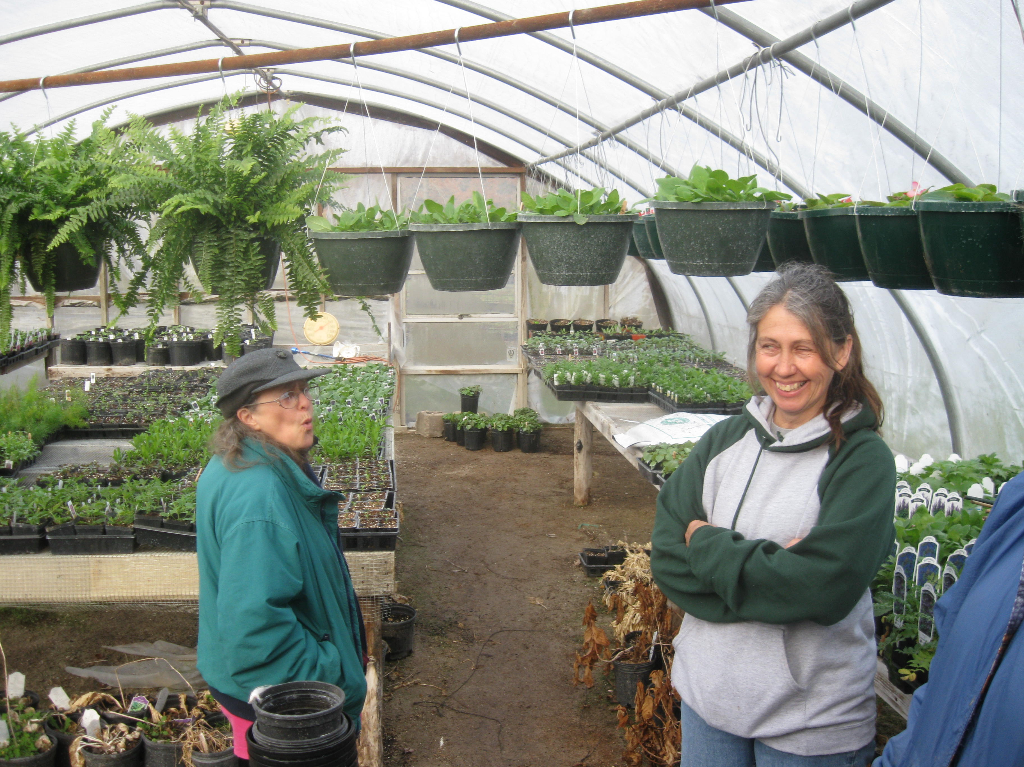
Program Examples - Ag and Natural Resources
- Plant and Animal Science
- Fruits and Vegetables
- Turf and Gardening
- Farm Management
- Forestry and Wood Products
- Wildlife
- Ag Marketing

Slide 27
Resources Available
University Publications
Educators Knowledge
Local Resources
Business Plans

Slide 28
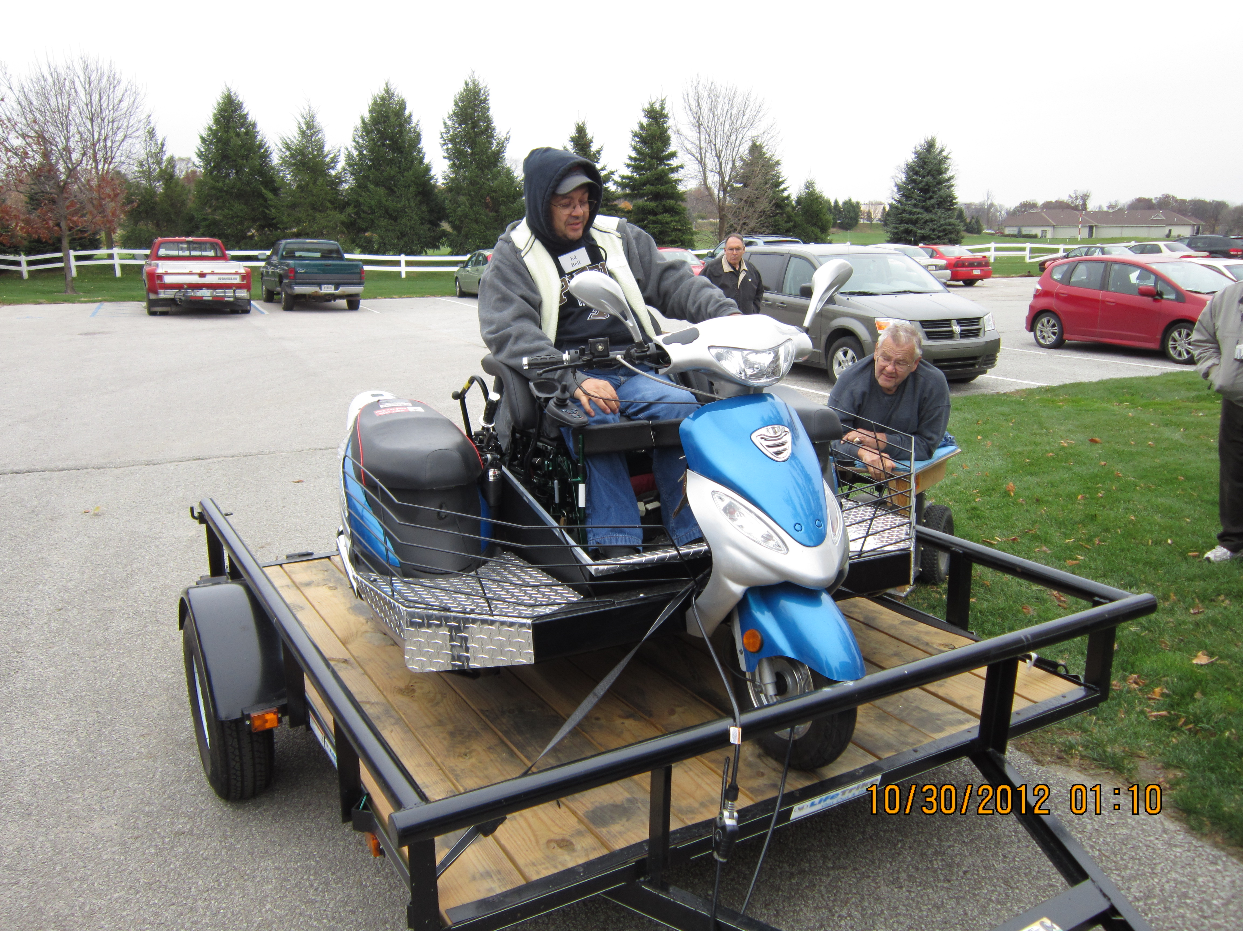
Disability and Agriculture
About AgrAbility
Project Contacts
Toolbox Assistive Technology Database
Resources
Communities of Interest
Online Training
AgrAbility National Training Workshop
Links to Other Resources
Contact Us

Slide 29

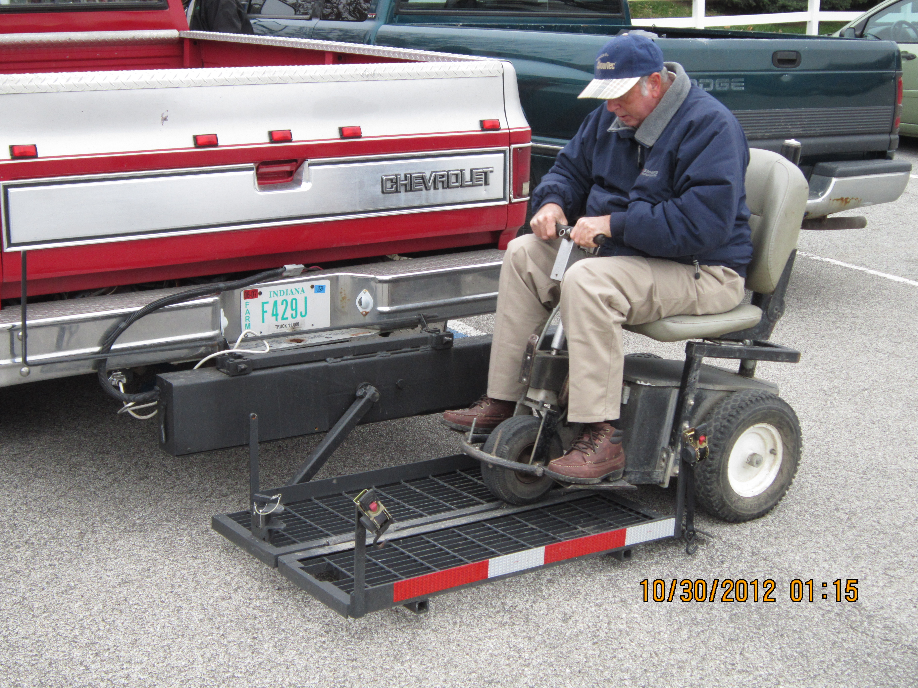
Decatur County:
Spinal injury
Amputation
Arthritis
Hearing
Health

Slide 30

The Toolbox: A resource for Farmers and Ranchers with Physical Disabilities that contains
•Products
•Designs and Ideas
•Techniques and Suggestions

Slide 31
Resources Available
Bureau of Rehabilitation Services (Indiana)
State Family and Social Services Administration
Division of Disability and Rehabilitative Services

Slide 32

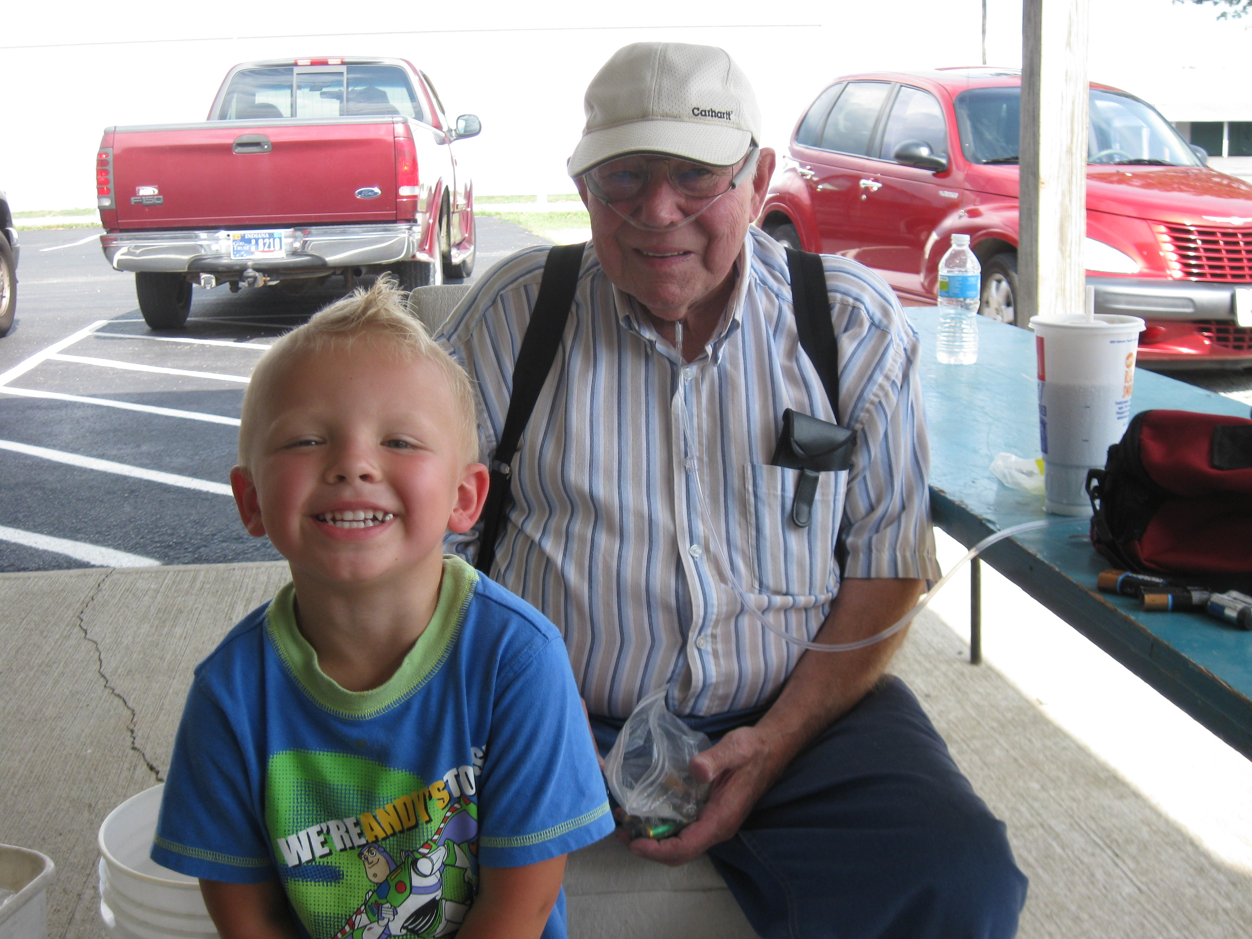
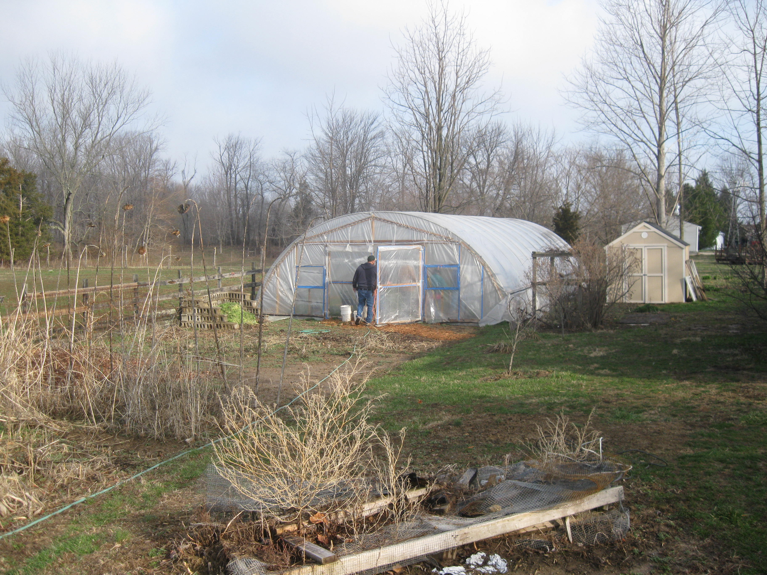
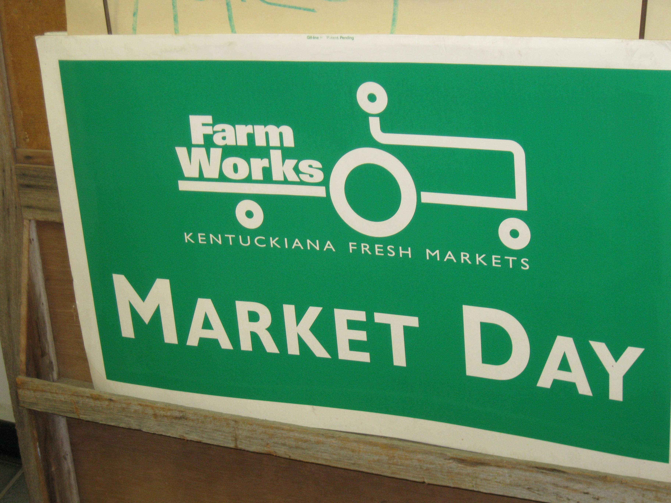
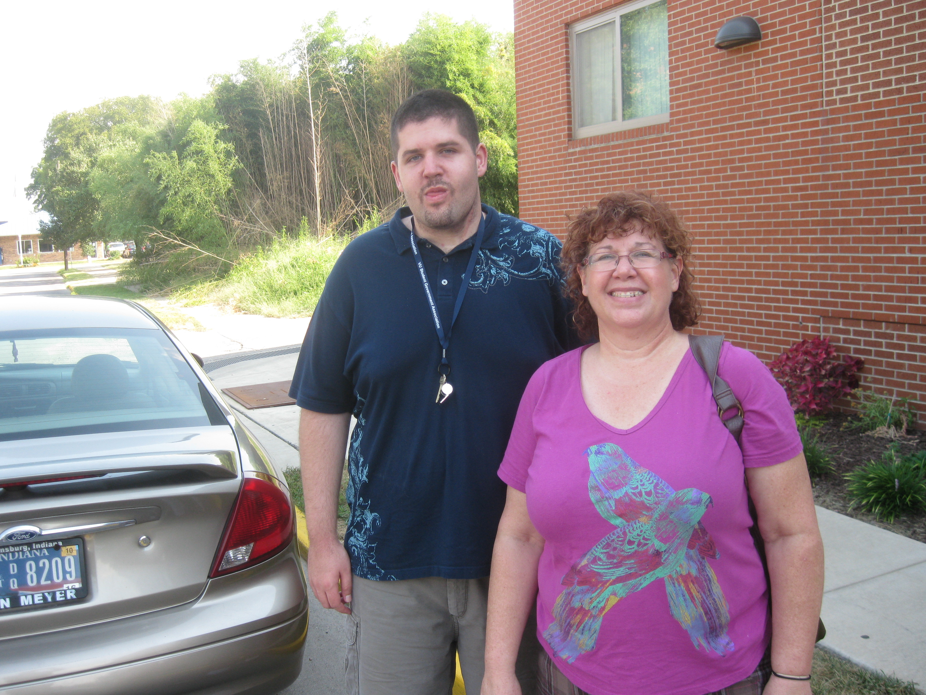

Slide 33
Thank You
Purdue Extension
Questions?

